Slide 1
Transparent AI Decision making dashboard
Team Members
Yashaswini Devineni
Sai Venkata Anil Thota
Uma Mahesh Vippalapally

Slide 2
Project Overview
The project objective is to increase the positive impact of AI solutions by adopting multiple measures and addressing their limitations in terms of accessibility and fairness.
This dashboard will include the elements like data representation, user feedback, Bias Analysis and educational resources
An engagement mechanism will be implemented to gather feedback, increasing interaction and model refinements

Slide 3
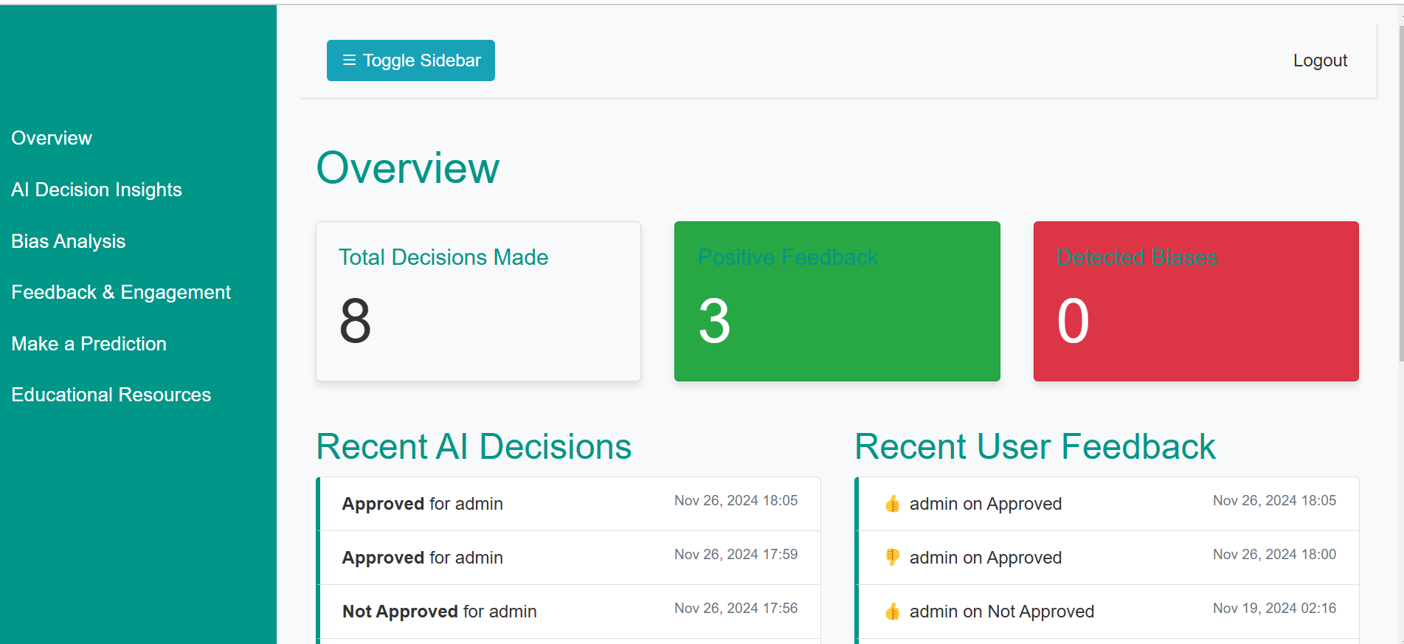
Features
Overview
This page includes the information like
Total Decisions Made
Positive Feedbacks
Detected Biases
Recent Ai Decisions
Recent User Feedback

Slide 4
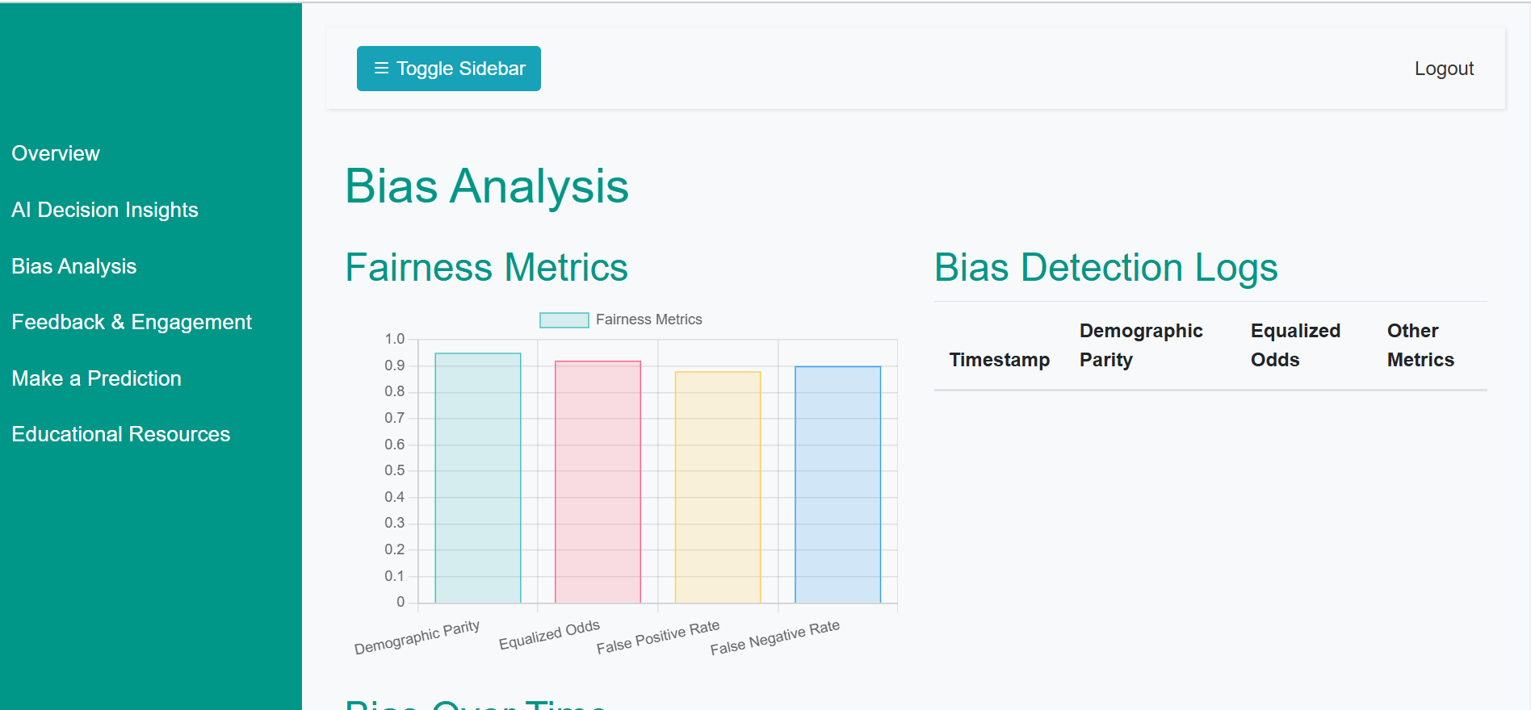
Features
Bias Analysis
Fairness Metrics and Bias Over Time will be displayed in this page
The metrics used for the fairness metrics
Demographic parity
Equalized Odds
False Positive Rate
False Negative Rate

Slide 5
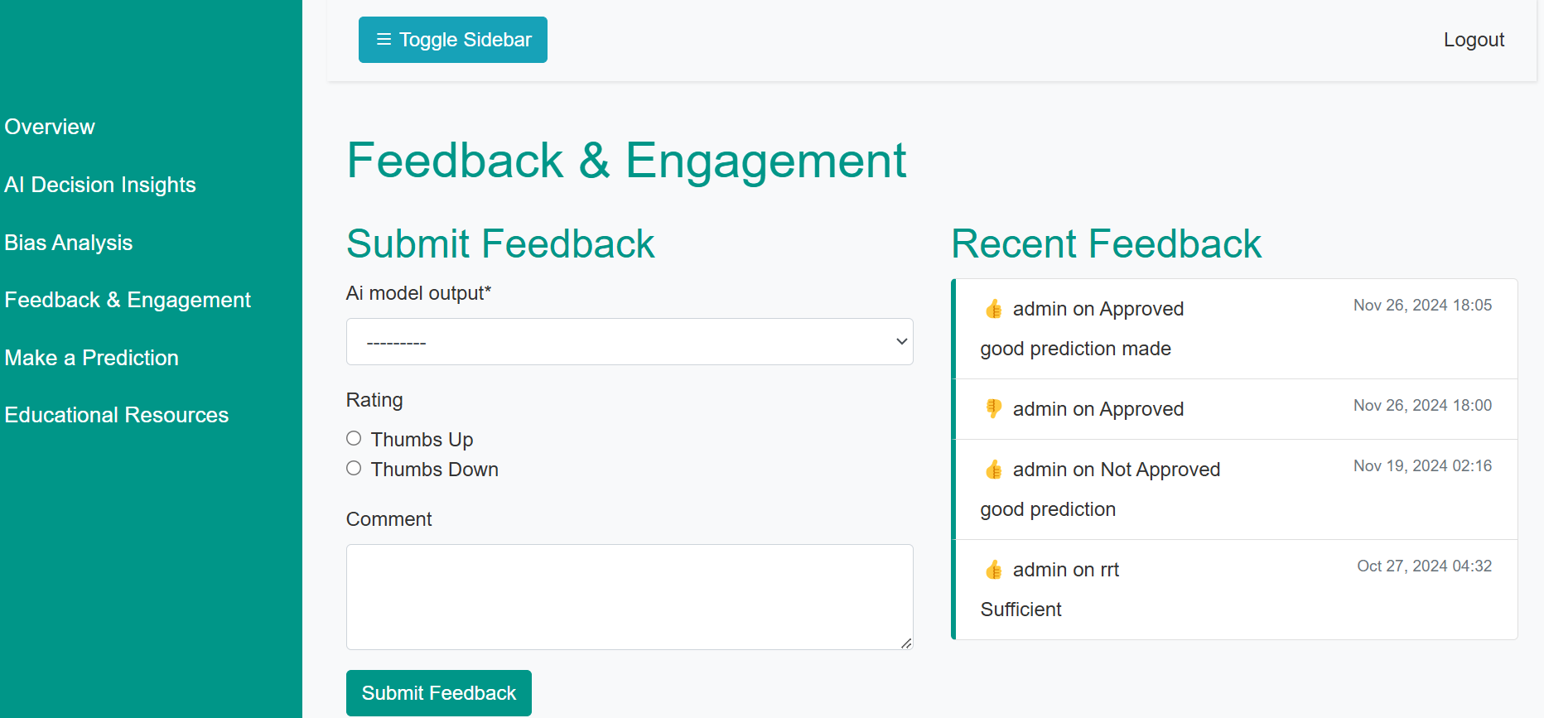
Features
Feedback & Engagement
User can choose the decision made and give the feedback
Thumbs Up & Thumbs Down are available for rating
User can also add comments for the decisions

Slide 6
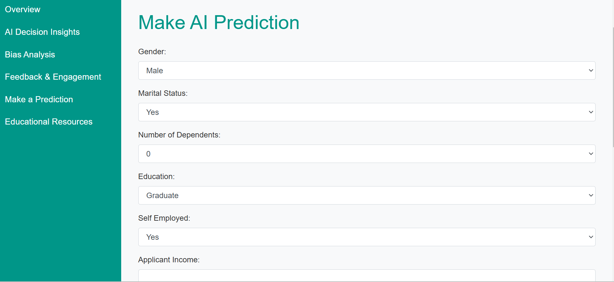
Features
Make a Prediction
User can give the required details and make the prediction
This dashboard makes the decisions for loan applications

Slide 7
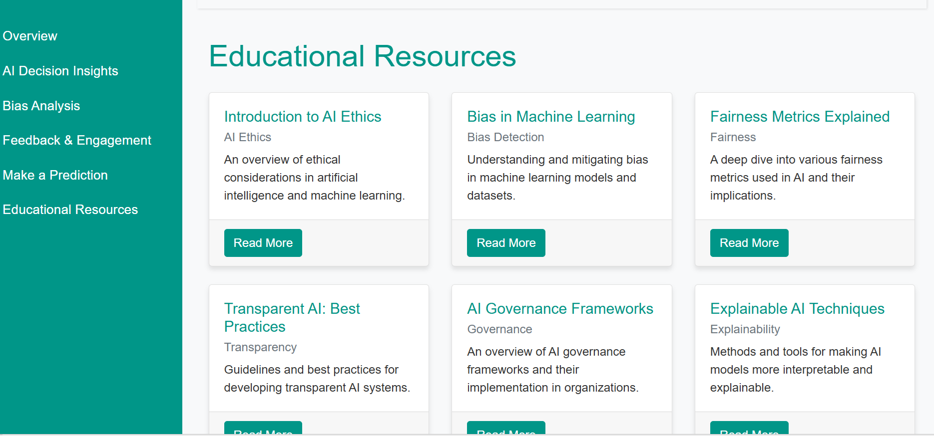
Features
Educational resources
This page includes the resources like Introduction to ethics, Bias in Machine Learning, Fairness Metrics, Transparent AI : Best Practices AI Governance frameworks and AI Techniques

Slide 8
Technical Architecture
Front End : HTML, CSS, Javascript, Bootstrap, Django
Backend : Django Framework (Python)
Bias Detection Engine : Tensorflow
Fairness Metric Engine : Fairlearn for statistical parity and demographic parity calculations. AIF360 for advanced fairness evaluations like equal opportunity.

Slide 9
Challenges
Difficulties in seamlessly integrating Django, TensorFlow, Fairlearn, and AIF360.
Challenges in ensuring high-quality, unbiased data for model training.
Balancing and incorporating multiple fairness metrics (e.g., demographic parity, equal opportunity).
Ensuring active participation from users in providing meaningful feedback.

Slide 10
Future Work
Enhanced Framework Integration:
Explore and implement tools or middleware to simplify the integration of Django, TensorFlow, Fairlearn, and AIF360.
Data Quality Assurance
Implement automated data validation pipelines to identify and rectify quality issues.
Improved Feedback Mechanisms
Introduce interactive tutorials and to encourage user participation.
Develop AI-driven feedback analysis to derive actionable insights.

Slide 11
Conclusion
This project aims to enhance the positive impact of AI solutions by addressing critical challenges in accessibility, fairness, and user engagement. The development of a user-friendly web-based dashboard, powered by robust frameworks like Django, TensorFlow, Fairlearn, and AIF360, ensures seamless interaction and fairness in AI decision-making.
Key features such as real-time bias detection, multiple fairness metrics, and an interactive feedback mechanism empower users to trust and contribute to AI systems. The incorporation of educational resources further promotes awareness and knowledge about ethical AI practices
Ultimately, this initiative establishes a strong foundation for ethical AI development, fostering transparency, fairness, and inclusivity in AI-driven decision-making systems.

Slide 12


